Slide 1
Unit 3
COMBINATIONAL CIRCUITS

Slide 2
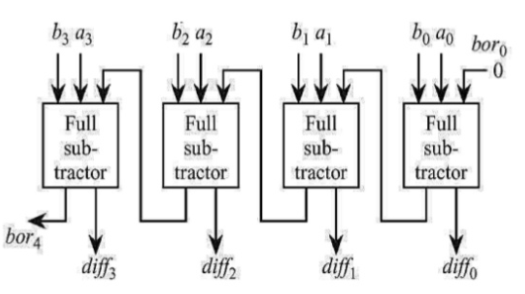
4-bit Parallel Subtractor using Full Subtractor

Slide 3
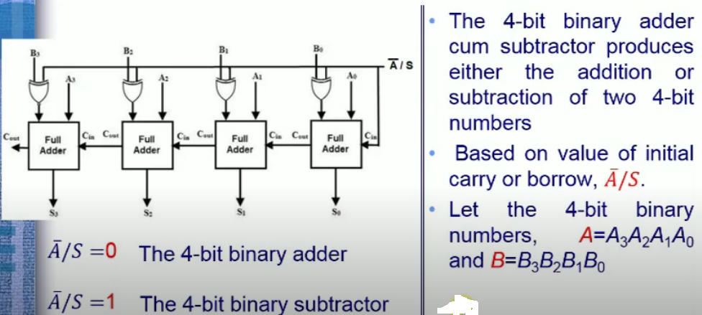

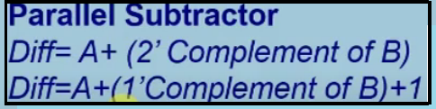
Parallel Adder/ Subtractor(4-bit)

Slide 4
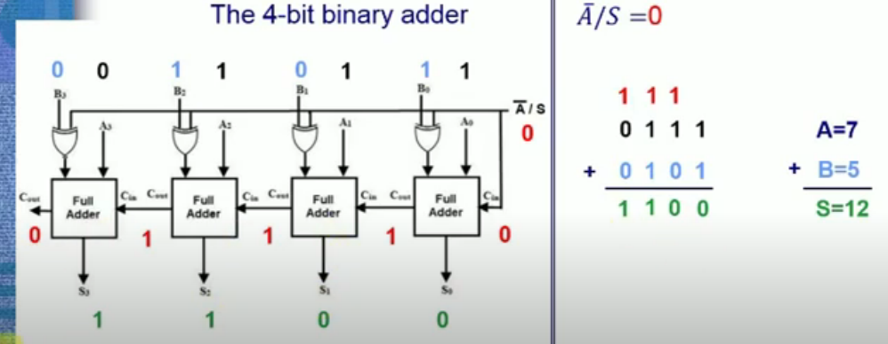
1.When work as a 4 bit binary adder

Slide 5
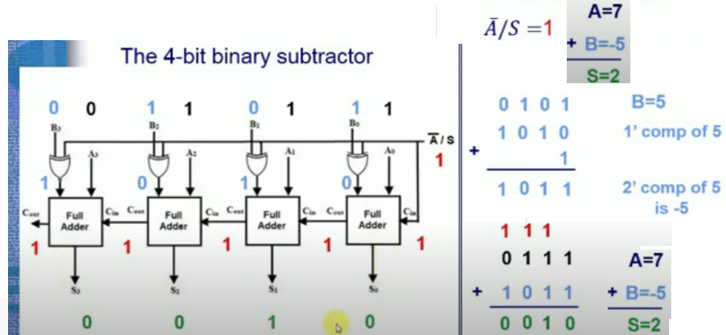
2.When work as a 4-bit binary subtractor

